Slide 1
Communicable Disease Solution
Outbreak Management Reporting Application (OMRA)
PowerPoint Prototype for Design Review
Notes:
The following presentation is intended for use for presenting the design planned for the new Alberta Outbreak Management System as part of the overall Communicable Disease Solution program. This presentation is intended to also be reviewed with the Outbreak Management Application Design (Web view) screen specifications and database design.
Presentation Approach
This presentation will be used initially with all affected user stakeholders in one meeting together. This includes CDC, SHE, PPHS, and TB with STI as optional
There will need to be additional working sessions on a screen by screen basis to confirm the build specifications before the developers actually start programming.
Note - The wireframe is intended to be just enough design to be able to start building the screens in the new application.
Version History
March 16 & 18, 2026 (Alec Blair and Juliane Mueller) – Initial draft with candidate slide notes

Slide 2
CDS Development Lifecycle
Communicable Disease Solution Project
Now
March 2026
TBD
Analysis
Design
Build
Validate
Workflows User Stories Acceptance Criteria Conceptual Solution Design | Application Specifications Wireframes Data Model Test Cases | Foundational Build User Experience Screens Application Workflows Functional Testing | User Acceptance Testing Curriculum Design Training Material Deploy into production
User stories just enough for design | Design supports ability to build Decision Requests as needed | Build meets acceptance criteria | Build confirmed to meet acceptance criteria
Notes:
From a Communicable Disease Solution perspective, we’re just finishing up the design stage of the project so that we can then move into the build phase of the project.

Slide 3
What is a PowerPoint Prototype?
Wireframes – These are wireframes that show what the proposed application screens will look like aligned to the proposed user stories
Specifications – Each screen has design specifications that:
Align screen fields to the proposed data model
Explain how buttons will work
Describe alerts for errors or incomplete information for some activities.
Just enough design – This is just enough design to move into the build stage where screens will be built iteratively and presented for review and approval as they are developed.
Notes:
Wireframes are intended to provide a quick sense of what the application user experience will look like. Aligned to the wireframes are the design specifications for each of the screens that also link to the application’s data model. The goal at this stage is not to go down to the complete level of detail for the whole solution. Rather, at this point we have moved from the conceptual to the logical level of design that will form the scaffolding required to start the detailed build.

Slide 4
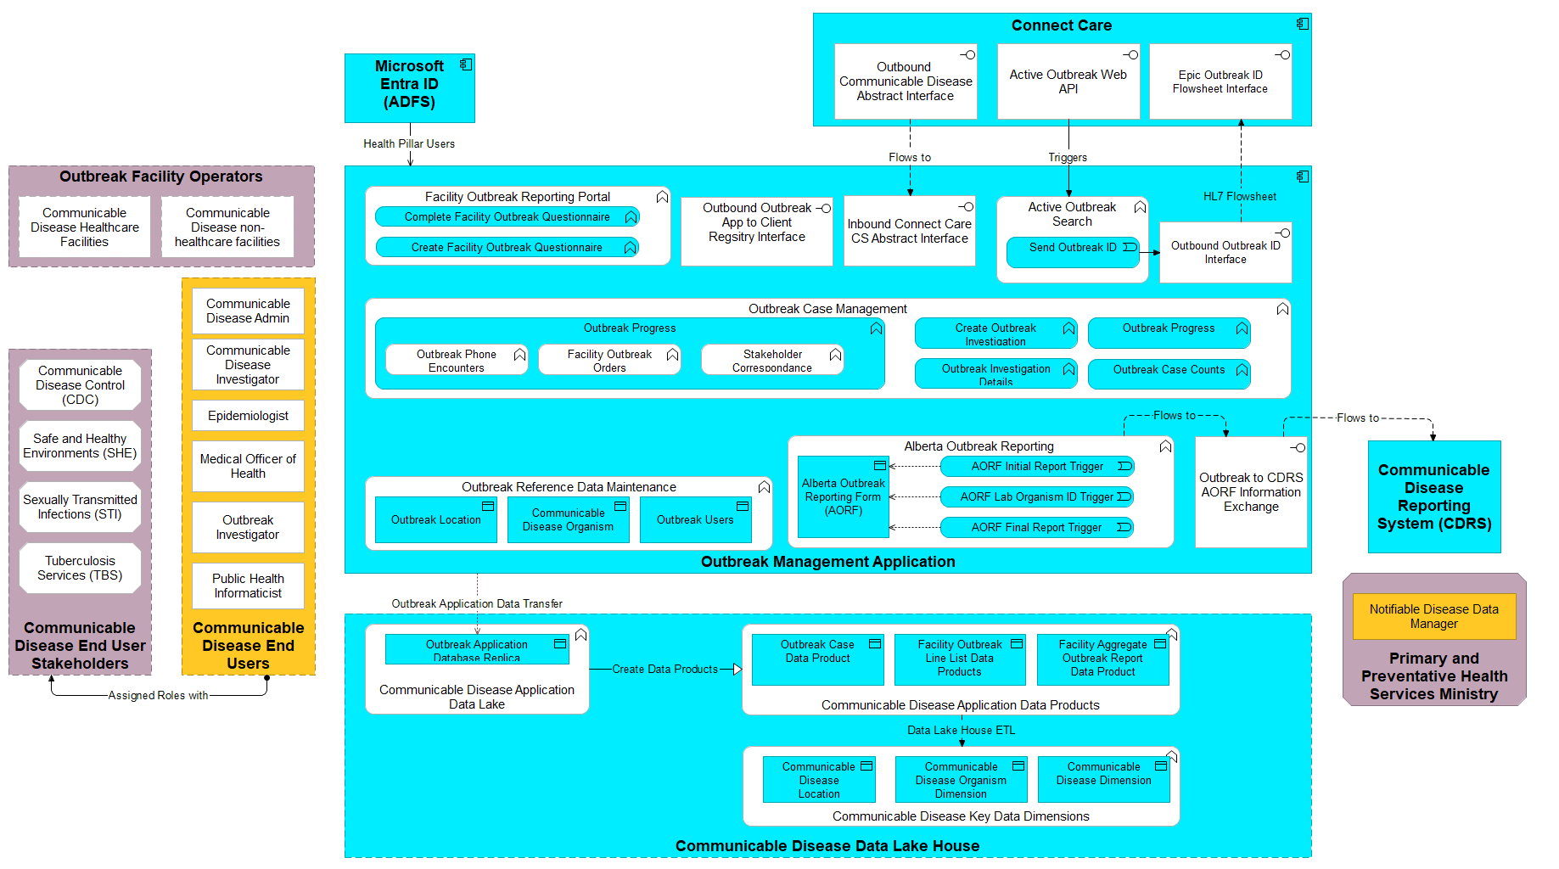
Alberta Outbreak Management System
Notes:
Through the design process, a number of things have changed since the conceptual design was first drafted in December 2025. This includes the following changes
The interface to access the EMPI and perform user validation was taken out since it will be easier to just open a communicable disease episode and lookup the patient in Connect Care. This decision may be revisited when we get to health care facility reporting that does allow for the provision of a ULI for patients.
A closed loop for Outbreak ID has been added to the design to reduce the probability of error when looking up a possible outbreak for given communicable disease
The Outbreak Application functional decomposition now reflects the new screens and associated wireframes.

Slide 5
Setting the OMRA Foundation
Managing Key Outbreak Entities
Users
Facilities
Organisms
Eliminating 'swivel-chair' interfaces
Reducing data duplication and manual re-entry
Making data accessible for the entire communicable disease domain.
Reuse CDOM User Experience (UX) where appropriate
Following published Disease Guidelines and Outbreak Submission guidelines
Notes:
As part of the overall design, it will be useful to start with the foundational data that will be pre-loaded into the new OMRA application, but will need to be updated over time. E.g data lake house

Slide 6
OMRA User Maintenance
Communicable Disease Solution
Alberta Outbreak Management Reporting Application (OMRA)
User Maintenance
*
First Name
Lookup Person
*
Last Name
+
Professional Designation
Role
▼
Organization
▼
▼
Department
▼
Address
+
Postal Code
+
Existing Users
Name | Role | Phone | E-mail
Save
Notes:
First off, we will need to provide access to the appropriate people. We will be leveraging Active Directory to look someone up so that we can then add a role and department for role-based access. A list of existing users will be at the bottom of the screen so that we avoid adding duplicates. This screen will be accessible from the Create Outbreak and the Outbreak Investigation Details screen. Existing user list optional for Quality Assurance to prevent duplicates.

Slide 7
OMRA Location Maintenance
Communicable Disease Solution
Alberta Outbreak Management Reporting Application (OMRA)
Facility Dictionary Maintenance
*
Setting Type
▼
*
Facility Name
+
Facility Aliases
Organization
▼
+
Address
+
Municipality
▼
Postal Code
▼
Zone/Corridor ​
Location 'Departments'
Department/Grade | Floor | Room
+
Save
Notes:
The goal with this screen will be to create and maintain data about facilities down to the unit, floor and room level. There is a plan to be able to sync with the ePHIS and Connect Care to have a master location cross reference across those applications. Other authoritative sources may also be added as they become available.
Need to confirm if we need total facility and client counts defined as well so that % of staff or patients affected can be calculated.

Slide 8
OMRA Disease Maintenance
Communicable Disease Solution
Alberta Outbreak Management Reporting Application (OMRA)
Communicable Disease Maintenance
Save
Disease Name
ICD-10-CA
Lab Procedures
Fastest Means Possible?
Associated Vaccine
Report Timing
Associated Symptoms
Closure Criteria
Outbreak Definition
Minimum Case Definition Rule
Confirmed Episode Conditions
Probable
with epi-link
Confirmed
Probable Episode Conditions
School Absenteeism
%
Congregate Care Cases
Rule Name | Condition | Date | Comments
 | And/or
Notes:
A key enhancement will be adding and maintaining organism attributes as well as outbreak criteria. This data will be loaded from the existing outbreak case definitions so that an automated check can be made to alert when an outbreak has met the appropriate criteria. It will also ensure that outbreak screens will be populated with only the fields that are appropriate for the given disease. For example, no fields for vaccine if the organism is not vaccine preventable.

Slide 9
Outbreak Value Stream
Communicable Disease Solution Design
Confirm
Exposure Trace
Manage
Close
Outbreak Notification
Create Questionnaire
Daily
Questionnaire
Update Investigation
Search Active Outbreaks
Complete Questionnaire
Complete Tasks
Final
AORF
Create
Investigation
Confirm Outbreak
Facility Orders
Update Investigation
Assess Outbreak
Lab Confirmed AORF
Initial AORF
Investigation Team
Epidemiologist
MOH
Facility
PPHS

Slide 10
OMRA Search
Outbreak Management Solution
Alberta Outbreak Management Reporting Application (OMRA)
Search
Investigation
Progress
Case Counts
Search
Export Outbreak ID
Create Outbreak
Outbreak ID | Outbreak Name | Date Opened | Date Closed | Status | Organism | Facility Type | Facility Name | Investigator | Region
00001 |  | May 14, 26 |  | Open |  | Daycare | Sunny Skies | Epi Demo | South
Notes:
This screen will be available within the Outbreak application and accessible from Connect Care as button on the Communicable Disease Abstract. We need to confirm if we can have the Outbreak Investigation ID sent back to Connect Care to auto populate the Communicable Disease Abstract.
This is a screen that will be used to lookup an existing outbreak to go into the further details as well as support the ability the creation of a new outbreak.

Slide 11
OMRA Create Outbreak
Communicable Disease Solution
Alberta Outbreak Management Reporting Application (OMRA)
Create Outbreak Investigation
Onset Date
Lead Investigator
▼
Description
*
*
Investigation 'Zone'
▼
*
Suspected Organism
▼
*
Outbreak Type
▼
Outbreak Setting
▼
Outbreak Region
▼
+
Outbreak Location
▼
Outbreak Department
▼
*
Outbreak Name
Index Case Abstract ID?
Y/N (Auto-populate)
Create
Notes:
Need to decide if we can auto-populate based on the original search from Epic for the Index case + we need the ability to manually enter an existing Abstract ID (maybe?)

Slide 12
OMRA Investigation Details
Communicable Disease Solution
Alberta Outbreak Management Reporting Application (OMRA)
ID
Name
Progress
▼
Resolution
▼
Search
Investigation
Tasks
Case Counts
Created
Filing Cabinet
Onset Date
Outbreak Cluster ID
Completed
PHAC Event #
International
No
*
Disease
*
Lead Investigator
▼
▼
Suspected Organism
*
Location Type
▼
Location
Secondary Organism
▼
Location Contact
▼
+
Outbreak Incident Narrative
Department/Grade
▼
Floor
▼
Edit Facility
Room
▼
Create Line List Questionnaire
Create Summary Questionnaire
Create Contact List
Notes:
The investigation details screen is where the details required for AORF submissions as well as non-mandatory fields are updated throughout the Outbreak lifecycle.
Note that the intent with the Cluster ID is that a 'master outbreak investigation' can be created that aggregates multiple other investigations together.

Slide 13
OMRA Investigator Case Load
Outbreak Management Solution
Alberta Outbreak Management Reporting Application (OMRA)
Search
Investigation
Tasks
Case Counts
Assigned Investigations
Outbreak ID | Outbreak Name | Organism | Facility Type | Facility Name | Investigator | Region
00001 |  |  | Daycare | Sunny Skies | Epi Demo | South
Assigned Tasks
Outbreak ID | Outbreak Name | Task | Description | Due Date | History | Status
Notes:
This screen will be available within the Outbreak application and accessible from Connect Care as button on the Communicable Disease Abstract. We need to confirm if we can have the Outbreak Investigation ID sent back to Connect Care to auto populate the Communicable Disease Abstract.
This is a screen that will be used to lookup an existing outbreak to go into the further details as well as support the ability the creation of a new outbreak.

Slide 14
OMRA Tasks or Activities
Outbreak Management Solution
Alberta Outbreak Management Reporting Application (OMRA)
ID
Name
Progress
Resolution
Search
Investigation
Tasks
Case Counts
Add Task
Due Date | Task | Description | Assigned | Contact
 | Phone Call
 | Initial AORF
 | Correspondence
 | Facility Order
 | Lab AORF
 | Final AORF
 | MoH Consult
Notes:
This needs more feedback on the types of tasks that need to be added

Slide 15
OMRA Create Questionnaire
Outbreak Management Solution
Create Facility Investigation (Line List or Aggregate) Questionnaire
Created
Outbreak Name
Outbreak ID
Outbreak Setting
Location
Disease
Demographics /Role | Signs /Symptoms | Lab | Result | Prophylaxis | Vaccinated
 |  | Y/N | +/- | Y/N
Demographics /Role | Hospital | Admitted | Cause of Death | Date
Additional Questions
Build Questionnaire
Notes:
The Create Questionnaire form will use the organism table information automatically create a default Facility or Outbreak questionnaire. This can be aggregate to line list. Additional fields can be added if needed for questions beyond the initial base design.

Slide 16
OMRA Create Contact Investigation
Outbreak Management Solution
Create Contact Investigation List
Created
Outbreak Name
Outbreak ID
Outbreak Setting
Location
Disease
Index Case Name
Demographics (Name, Address, Phone, Gender) | Exposure Location​ | Relationship to Contact | Disease Questions | Contact Attempt/ Result | PHN
Query PHN
Create Episode
Notes:
The Create Questionnaire form will use the organism table information automatically create a default Facility or Outbreak questionnaire. This can be aggregate to line list. Additional fields can be added if needed for questions beyond the initial base design.

Slide 17
OMRA Submit Questionnaire
Outbreak Management Solution
Create Facility Investigation (Line List or Aggregate) Questionnaire
Created
Outbreak Name
Outbreak ID
Outbreak Setting
Location
Disease
Download Excel
Download .pdf
Submission History
▼
Demographics /Role | Signs /Symptoms | Lab | Result | Vaccinated
Demographics /Role | Hospital | Admitted | Cause of Death | Date
Submission Date
Upload File
Save
Validate
Notes:
Once the questionnaire has been created, there will a dedicated web page that can be in three ways:
Fill additional/updated data in the web page directly.
Download a custom Excel spreadsheet that can filled in and uploaded by the facility each day or;
Create a fillable .pdf that can be submitted, but then would need to be transcribed if manually completed.

Slide 18
OMRA Case Counts
Outbreak Management Solution
Alberta Outbreak Management Reporting Application (OMRA)
ID
Name
Progress
Resolution
Search
Investigation
Tasks
Case Counts
Created
Outbreak Name
Outbreak ID
Outbreak Setting
Primary Organism
Location
Secondary Organism
 | Clients | Staff | Total
Total Suspects Cases
Total Probable Cases
Cumulative Cases
Hospitalized Cases
Deceased Cases
Demographics | Symptoms | Lab | Result | Prophylaxis | Vaccinated
 |  | Y/N | +/- | Y/N
Note to add non-people lab results
Notes:
The Outbreak Case Count Screen is an overall report that supports AORF submission detail. This will have both summary and where there is a line list, individual questionnaire entries aggregated

Slide 19
Next Steps
SBAR – Recommendation
Explain the key considerations that need to be actioned on, the high-level plan and next steps.
Moving from Design to Build
Screen-based prototype build specifications
Who should participate in the detailed specifications?
How can we engage the appropriate subject matter experts?

Slide 20
Questions?

Slide 21
People who contributed to the SBAR
SBAR – People Consulted
If required, keep a list of people involved in the consultation – potentially by date consulted.
[Enter text here]

